Slide 1
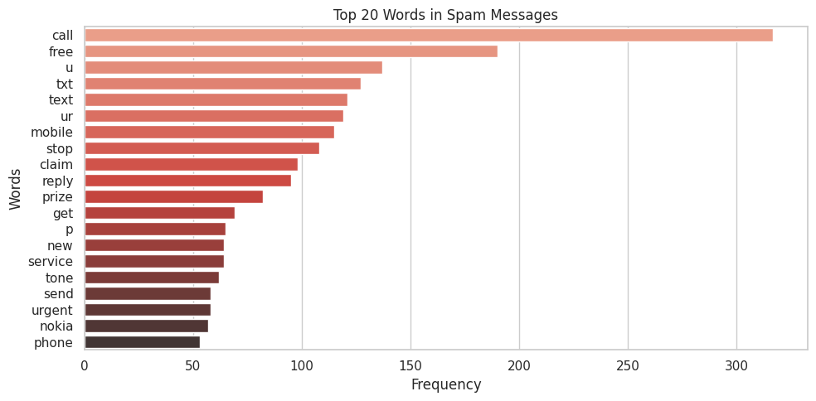
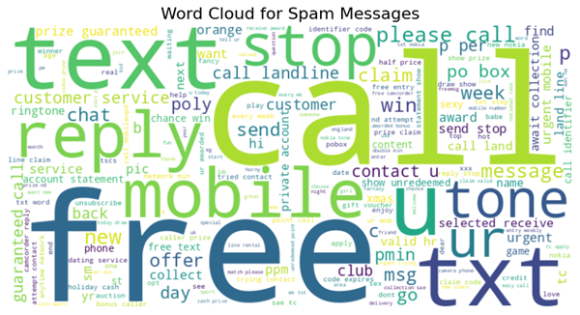
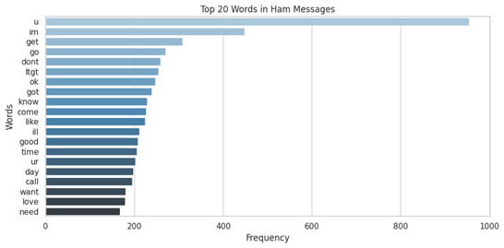
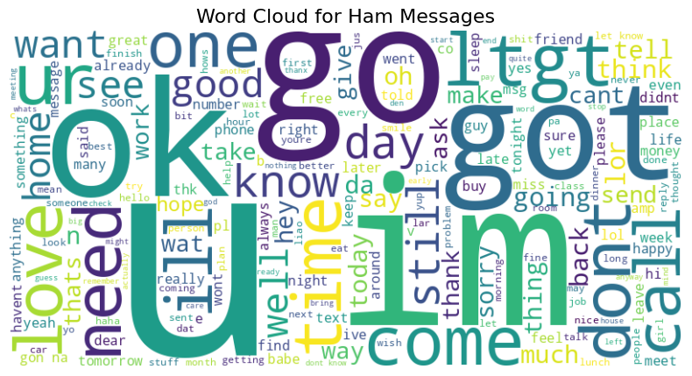
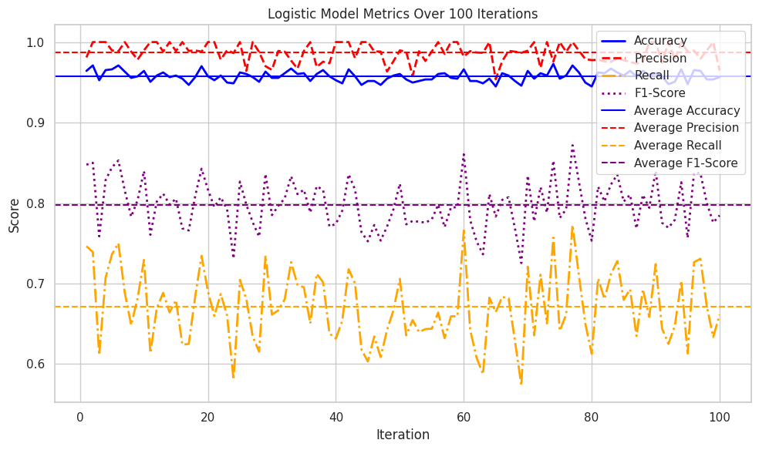
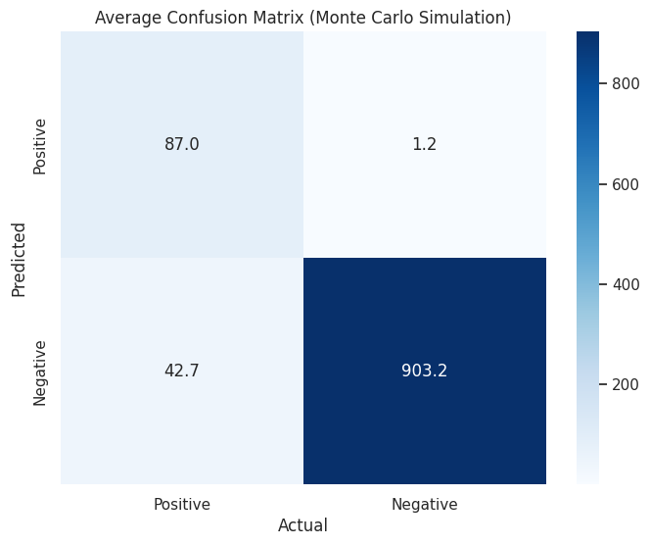
Department of Computing, Goldsmiths, University of London
Oluomachukwu Otuadinma,
ootua001@gold.ac.uk
"Exploring NLP Techniques for Spam Detection: A Comparative Evaluation of Classifiers"

Slide 2
